Slide 1
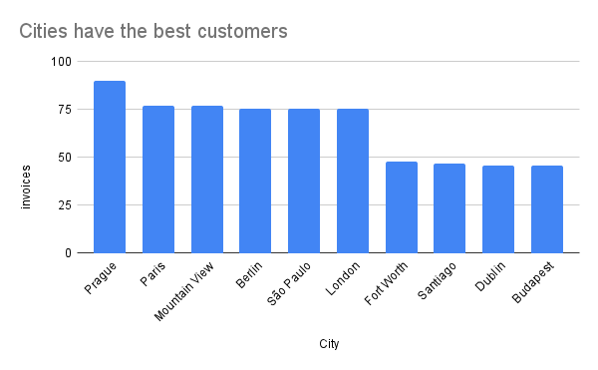
Which city has the best customers?
<visualization>
The top city for Invoice dollars was Prague, with an amount of 90.24.

Slide 2
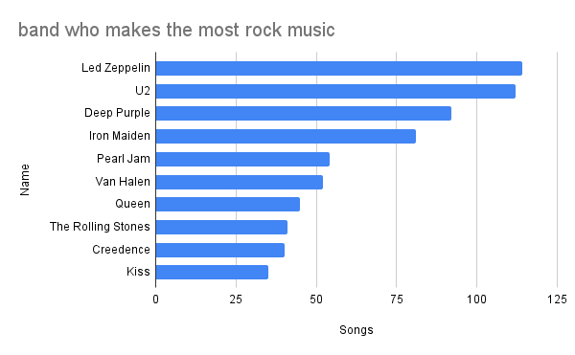
Who is the band who makes the most rock music?
<visualization>
Led Zeppelin is the band that makes the most rock songs, with 114 songs followed by u2 with 112 songs

Slide 3
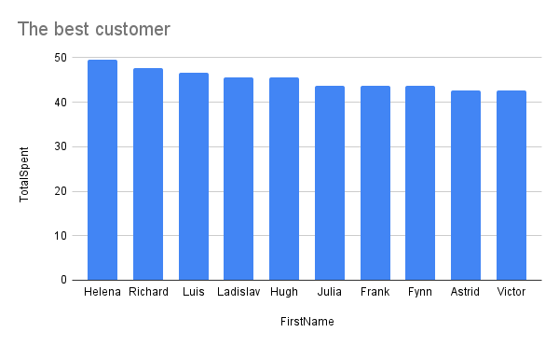
Who is the best customer who has spent the most money?
<visualization>
The customer who spent the most according to invoices was Customer 6 Helena, with 49.62 in purchases

Slide 4
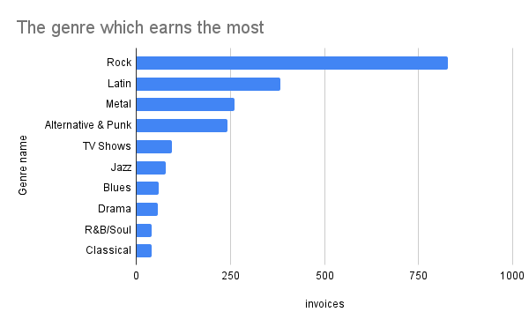
what is the genre which earns the most
<visualization>
The genre that earns the most is Rock with 827

